Slide 1

LECTURE 2: Agent Building Tools
KD04603 Special Topic in Computer Science
Taken and modified from “Agent Technology for e-Commerce” by Maria Fasli and “JADE Tutorial: JADE Programming for Beginners” by Giovanni Claire (TILAB)
KK04203 Intelligent Agents

Slide 2
Expected learning outcomes
To understand the basic architecture of JADE
To understand the core concepts of FIPA
KK04203 Intelligent Agents
Notes:
Foundation for Intelligent Physical Agent (FIPA)

Slide 3
Outline
Programming languages and environment for agent
Java Agent Development (JADE) framework
FIPA
KK04203 Intelligent Agents
Notes:
Foundation for Intelligent Physical Agent (FIPA)

Slide 4
Programming languages and environments
Currently, no languages support agent-oriented programming at a high level of abstraction
The first attempts was Agent-Oriented Programming (AOP) paradigm (AGENT0)
Logic-Based approaches to agent programming: METATEM, AgentSpeak(L), Jason
Toolkits and environments to support the agent developer mostly based on Java: ZEUS, JADE, JACK Intelligent Agents, JATLite, Aglet
KK04203 Intelligent Agents

Slide 5
JADE (Java Agent Development Framework)
Started by Telecom Italia in 1998 to validate the early FIPA specifications
Went open source in 2000
JADE website: http://jade.tilab.com

Slide 6
Functions Offered
Fully distributed system
Full compliance with FIPA specifications
A simple agent life-cycle management
Support for agent mobility
Graphical tools
Support for ontologies and content languages (e.g. XML)
Library of interaction protocols
Integration with various web-based technologies, etc.

Slide 7
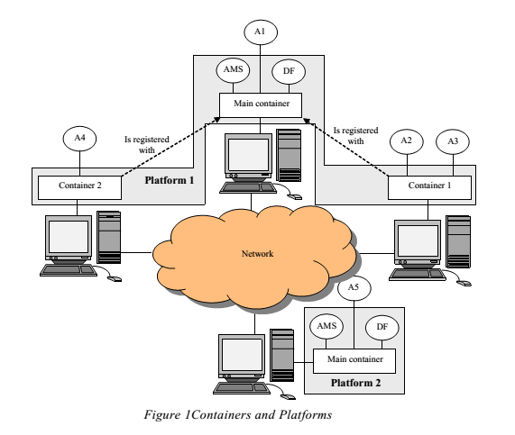
JADE Architecture
An application contains more than one Agent
Agent lives on a Platform
Identified by AgentIdentifier or AID
Host 2
Host 1
Host 3
Host 4

Slide 8
JADE Architecture
Platform 1
Host 2
Host 1
Host 3
Provide basic services such as message delivery
Composed of one or more Containers
Host 4

Slide 9
JADE Architecture
Containers
Can be executed on different hosts -> distributed platform
Can contain zero or more agents
You can think of a Container as JVM
Main Container is a special container
Host 2
Host 1
Host 3
Host 4
Notes:
Java virtual machine

Slide 10
JADE Architecture
Main Container
The first container in a platform
Other containers register to it
It includes two special agents: AMS (Agent Management System) and DF (Directory Facilitator)
Host 2
Host 1
Host 3
Host 4
Notes:
AMS (Agent Management System)
DF (Directory Facilitator)

Slide 11
Agent Communication
Using Agent Communication Language (ACL) defined by Foundation for Intelligent Physical Agent (FIPA)
Contains a number of fields including:
the sender
the receiver(s)
the communicative act (e.g. INFORM, REQUEST)
the content (the actual information conveyed)

Slide 12
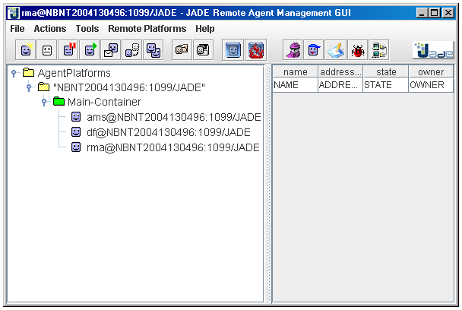
Admin & Debugging Tools
rma (Remote Management Agent), the agent implementing the console
Platform Management Console

Slide 13
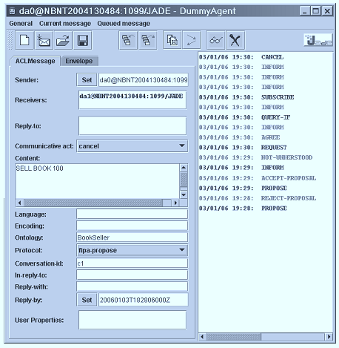
Admin & Debugging Tools
The DummyAgent
A simple tool that is useful for sending stimuli, in the form of ACL messages, to test the behaviour of another agent

Slide 14
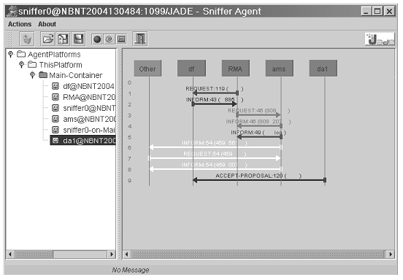
Admin & Debugging Tools
Sniffer Agent
Documenting conversations between agents

Slide 15
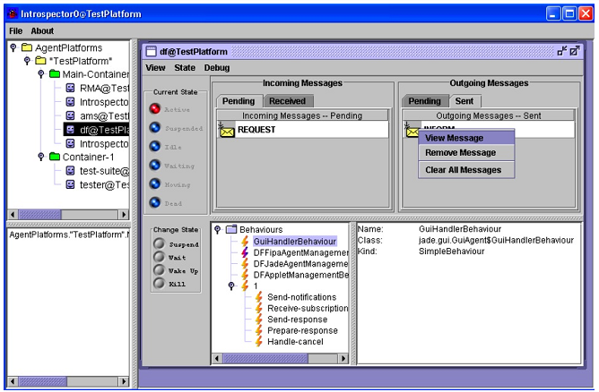
Admin & Debugging Tools
Introspector Agent
Debug the behaviour of a single agent

Slide 16
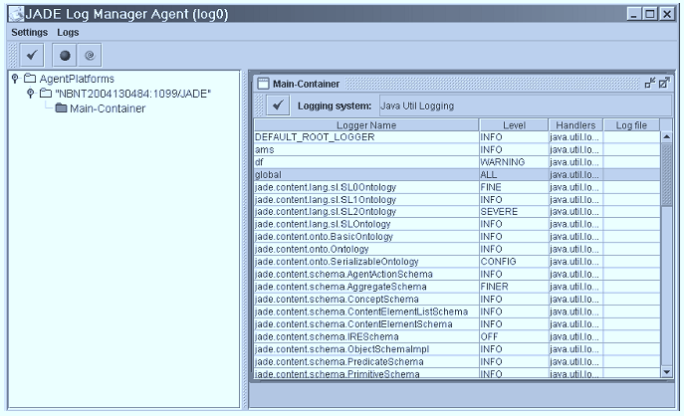
Admin & Debugging Tools
Log Manager Agent
A tool that simplifies the dynamic and distributed management of the logging facility by providing a graphical interface that allows the levels of each component of the JADE platform to be changed at run-time

Slide 17
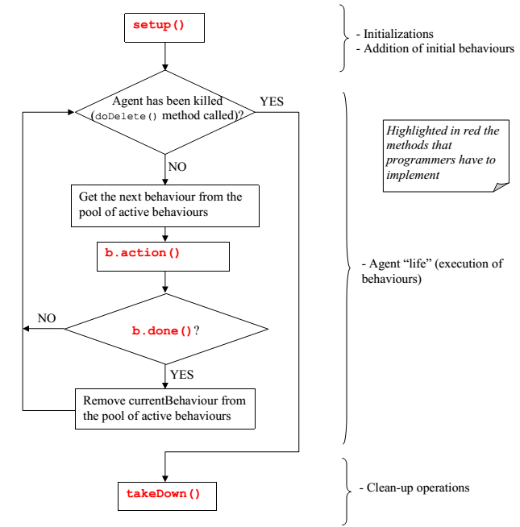
Agent Cycle
Texts highlighted in red is the methods that programmers have to implement

Slide 18
Agent Example
import jade.core.Agent;
import jade.core.behaviours.CyclicBehaviour;
import jade.lang.acl.ACLMessage;
public class HelloWorldAgent extends Agent {
public void setup() {
System.out.println("Hello. My name is "+getLocalName());
addBehaviour(new CyclicBehaviour() {
public void action() {
ACLMessage msgRx = receive();
if (msgRx != null) {
System.out.println(msgRx);
ACLMessage msgTx = msgRx.createReply();
msgTx.setContent("Hello!");
send(msgTx);
} else {
block();
}
}
});
}
}

Slide 19
Foundation for Intelligent Physical Agent (FIPA)
An IEEE Computer Society standards organization that promotes agent-based technology
Originally formed as a Swiss based non-profit organization in 1996

Slide 20
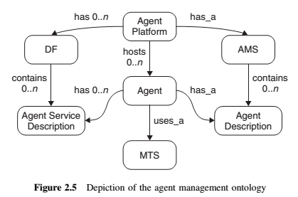
FIPA Core Concepts
Agent communication
FIPA – Agent Communication Language (ACL) (utilize Open Systems Interconnection (OSI) Reference Model and TCP/IP)
Sub-layers
7 layers: Transport (WAP, HTTP etc.), encoding (XML etc.), messaging, ontology, content expression (not, or, implies etc.), communicative act (inform, request etc.) and interaction protocol
Agent management
Abstract architecture
specifies the ACL message structure, message transport, agent directory services and service directory as mandatory
AMS = agent management system

Slide 21
FIPA Specifications
FIPA1. SC00001, FIPA Abstract Architecture Specification.
FIPA8. SC00008, FIPA SL Content Language Specification.
FIPA14. SI00014, FIPA Nomadic Application Support Specification.
FIPA23. SC00023, FIPA Agent Management Specification.
FIPA26. SC00026, FIPA Request Interaction Protocol Specification.
FIPA27. SC00027, FIPA Query Interaction Protocol Specification.
FIPA28. SC00028, FIPA Request When Interaction Protocol Specification.
FIPA29. SC00029, FIPA Contract Net Interaction Protocol Specification.
FIPA30. SC00030, FIPA Iterated Contract Net Interaction Protocol Specification.
FIPA33. SC00033, FIPA Brokering Interaction Protocol Specification.
FIPA34. SC00034, FIPA Recruiting Interaction Protocol Specification.
FIPA35. SC00035, FIPA Subscribe Interaction Protocol Specification.
FIPA36. SC00036, FIPA Propose Interaction Protocol Specification.
FIPA37. SC00037, FIPA Communicative Act Library Specification.
FIPA61. SC00061, FIPA ACL Message Structure Specification.
FIPA67. SC00067, FIPA Agent Message Transport Service Specification.
FIPA69. SC00069, FIPA ACL Message Representation in Bit-Efficient Specification.
FIPA70. SC00070, FIPA ACL Message Representation in String Specification.
FIPA71. SC00071, FIPA ACL Message Representation in XML Specification.
FIPA75. SC00075, FIPA Agent Message Transport Protocol for IIOP Specification.
FIPA84. SC00084, FIPA Agent Message Transport Protocol for HTTP Specification.
FIPA85. SC00085, FIPA Agent MessageTransport Envelope Representation in XML Specification.
FIPA88. SC00088, FIPA Agent Message Transport Envelope Representation in Bit Efficient Specification.
FIPA91. SI00091, FIPA Device Ontology Specification.
FIPA94. SC00094, FIPA Quality of Service Specification.
Notes:
FIPA specifications represent a collection of standards which are intended to promote the interoperation of heterogeneous agents and the services that they can represent.

Slide 22
Summary
JADE platform and architecture were described
The core concept of FIPA was presented
What’s next?
Agent architectures
KK04203 Intelligent Agents

Slide 23
Reading assignment
Agents for information retrieval and management
Agents for e-commerce/ shopping
Recommender systems
Agents in traffic and transportation systems
Agents in the Internet of Things

